Slide 1
INTERNSHIP REPORT
  INTERNSHIP TITLE : Zero-Shot Vision-Language Model Applications
  STUDENT NAME : SARASWATHY M
  REGISTER NUMBER : 110725102221
  DEPARTMENT : Artificial Intelligence & Data Science
  YEAR & SEMESTER : II ^{nd} year/ III sem
  ORGANIZATION : Pentabrains Solutions Private Limited, Chennai
  INTERNSHIP DURATION : 03/08/2026 – 14/08/2026
  ACADEMIC YEAR : 2026–2027

Slide 2
ABOUT THE ORGANIZATION
Organization Name: Pentabrains Solutions Private Limited
Industry / Domain : Application development
Location: Chennai, Tamil Nadu
Major Products / Services: Application development, artificial intelligence, computer vision, Vision-Language Model applications, and software development.
Organization Profile:
Pentabrains Solutions Private Limited is an organization based in Chennai, Tamil Nadu.
The internship focused on application development and Zero-Shot Vision-Language Model applications.
The internship provided practical exposure to VLM fundamentals, computer vision, prompt engineering, model evaluation, and application development.

Slide 3
TECHNOLOGIES AND TOOLS USED
Programming Languages: Python, HTML, CSS
Frameworks / Libraries: Flask, Py Torch, Transformers, PIL (Pillow), NumPy
Database: PostgreSQL
Software / Platforms: Visual Studio Code, Python, Flask Development Environment
Hardware / Devices: Computer / cpu: intel i5 12th gen gpu: rtx3050 ram: 16gp vram:6gb
Other Technologies: Artificial Intelligence (AI), Vision-Language Models (VLMs), Computer Vision, Moondream, CLIPSeg, Zero-Shot Learning, Prompt Engineering

Slide 4
PROJECT / PROBLEM STATEMENT
Project Title: Zero-Shot Vision-Language Model Application (CHATLYTIX)
Problem Identified: The project focuses on developing an application that can work with images using Vision-Language Models and natural-language queries.
Proposed Solution: Develop CHATLYTIX as a web-based Zero-Shot Vision-Language Model application for image understanding and natural-language interaction.
Need for the Project :The project provides practical application of Vision-Language Models by allowing users to interact with image data through natural-language instructions.
.

Slide 5
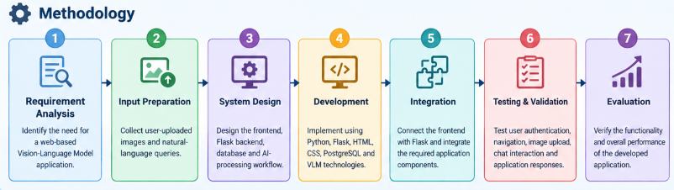
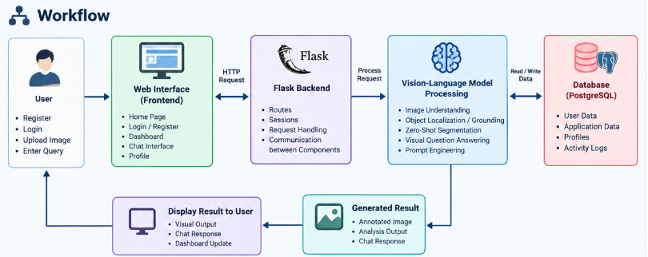
METHODOLOGY / WORKFLOW

Slide 6
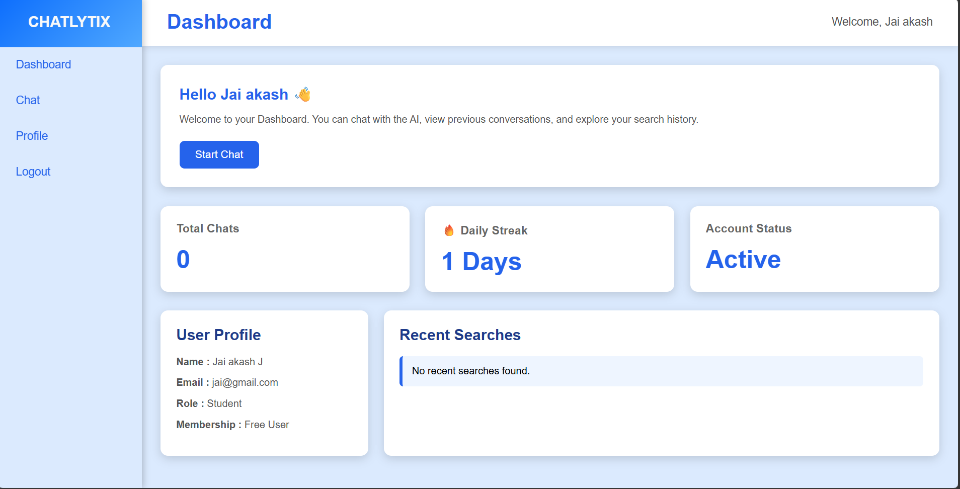
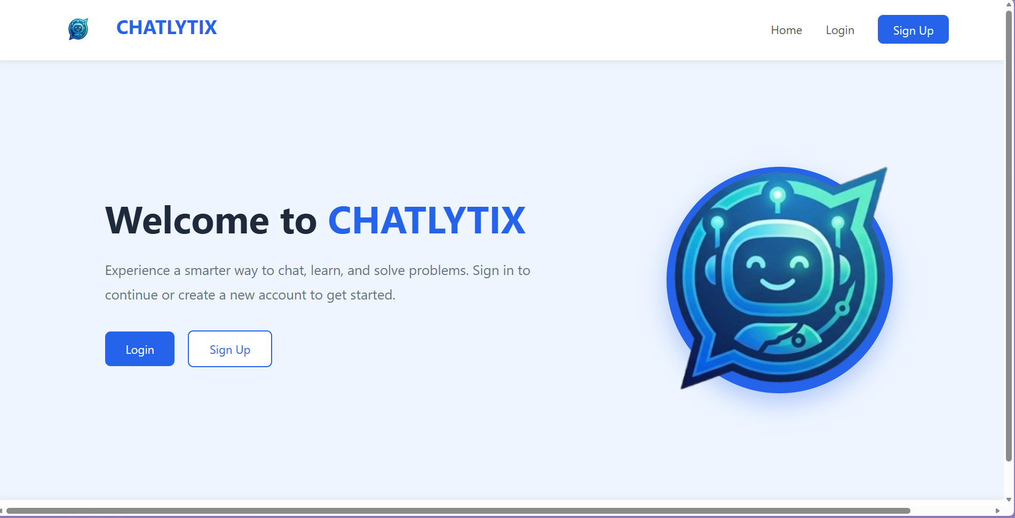
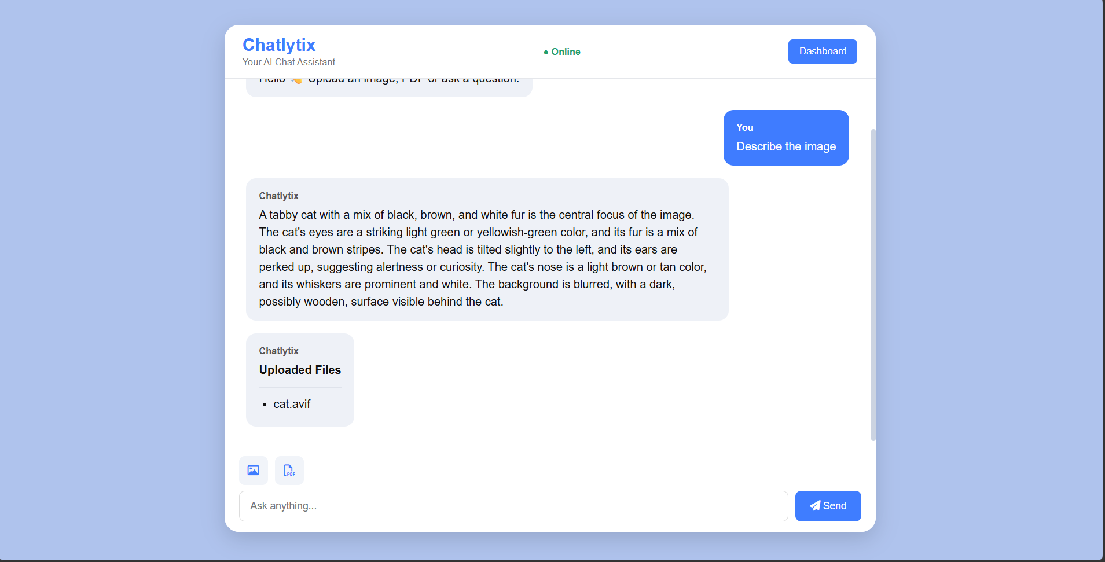
OUTPUT

Slide 7
RESULTS / OUTCOMES
Results
CHATLYTIX was successfully developed as a web-based Vision-Language Model application.
The application successfully supports image upload and AI-based image analysis.
The major application modules and navigation routes were tested successfully.
Outcomes
Gained practical experience in Python, Flask, HTML, CSS, and PostgreSQL.
Developed understanding of Vision-Language Models, zero-shot applications, image analysis, and prompt engineering.
Gained hands-on experience in integrating AI technologies with a functional web application.

Slide 8
THANK YOU
STUDENT NAME : SARASWATHY M
REGISTER NUMBER : 110725102221
DEPARTMENT : Artificial Intelligence & Data Science

